Slide 1


AERIAL CROP MONITORING AND YIELD PREDICTION USING AERIAL IMAGERY
SIMATS ENGINEERING
SAVEETHA INSTITUTE OF MEDICAL AND TECHNICAL SCIENCES
Capstone Project Review-1
ITA0506_Computer Vison
PRESENTED BY:
K. Manoj Kumar(192472395)
P.V D NAGENDRA REDDY(192472399)
pranay km(192321055)
Lenin K(192321050)
Program Director:
Dr.Sasi Rekha,Prof/CSE
Guided By:
Mrs.R C Jeni Gracia, AP / CSE

Slide 2
Agenda
Introduction
Literature Review
Problem Statement
Objectives
System Architecture – Overall Design
Introduction Project Modules
Future Enhancement
Conclusion

Slide 3
Introduction
Agriculture plays a vital role in ensuring global food security and economic development.
Traditional crop monitoring methods are labor-intensive, time-consuming, and limited in coverage.
Aerial imagery provides high-resolution data for monitoring crop conditions over large agricultural fields.
Artificial Intelligence (AI) and Machine Learning (ML) techniques enable automated crop health assessment and yield prediction.
This project integrates aerial imagery, image processing, deep learning, and data analytics to assist farmers in making informed decisions.

Slide 4
Literature Review
S.No | Author & Year | Title | Journal / Conference | Technologies Used | Limitations
1 | Li Zhang et al., 2025 | Deep Learning-Based Crop Disease Detection Using UAV Aerial Images | IEEE International Conference on Smart Agriculture (ICSA 2025) | UAV Imagery, CNN, Deep Learning, OpenCV | Performance decreases under varying lighting conditions.
2 | Maria Gonzalez et al., 2025 | AI-Driven Crop Health Monitoring Using Multispectral Aerial Imagery | Computers and Electronics in Agriculture (Elsevier) | Multispectral Imaging, AI, TensorFlow, GIS | Requires expensive multispectral cameras.
3 | Rahul Sharma et al., 2026 | Machine Learning Framework for Crop Yield Prediction Using Aerial Images | IEEE Access | Machine Learning, Random Forest, Python, Drone Imaging | Prediction accuracy depends on the quality of training data.
4 | Ahmed Hassan et al., 2025 | Precision Agriculture Using Deep Learning and Remote Sensing | International Conference on Artificial Intelligence and Data Analytics (ICAIDA 2025) | Deep Learning, Remote Sensing, Image Processing | Limited validation across different crop varieties.
5 | Emily Johnson et al., 2026 | Intelligent Crop Monitoring and Yield Estimation Using Computer Vision | ACM International Conference on Intelligent Computing Systems (ICICS 2026) | Computer Vision, CNN, OpenCV, TensorFlow | High computational requirements for real-time processing.
6 | S. Ramesh et al., 2025 | Crop Health Assessment Using Aerial Image Analysis and Deep Learning | International Journal of Advanced Computer Science and Applications (IJACSA) | Python, Deep Learning, Image Segmentation | Reduced accuracy in cloudy weather conditions.
7 | Yuki Tanaka et al., 2026 | Smart Agriculture: Aerial Image-Based Crop Monitoring with AI Analytics | IEEE International Conference on Computational Intelligence and Smart Systems (CISS 2026) | Artificial Intelligence, GIS, CNN, IoT | Large datasets increase processing time.
8 | Priya Nair et al., 2025 | Automated Crop Yield Prediction Using Deep Neural Networks and Aerial Imagery | Springer International Conference on Machine Learning and Data Engineering (MLDE 2025) | Deep Neural Networks, Python, TensorFlow, Image Processing | Limited generalization to diverse geographical regions.

Slide 5
Problem Statement
Farmers face challenges in identifying crop stress, diseases, and nutrient deficiencies at an early stage.
Manual crop inspection is costly, slow, and prone to human error.
Inaccurate yield estimation affects harvesting, storage, and market planning.
There is a need for an intelligent system that automatically monitors crop conditions and predicts yield using aerial imagery and AI-based analytics.

Slide 6
Objectives
Acquire high-quality aerial images of agricultural fields.
Detect crop health issues and diseases using image processing and deep learning.
Predict crop yield using machine learning algorithms.
Provide an interactive dashboard for visualization, monitoring, and decision support.
Improve agricultural productivity through timely and data-driven insights.

Slide 7
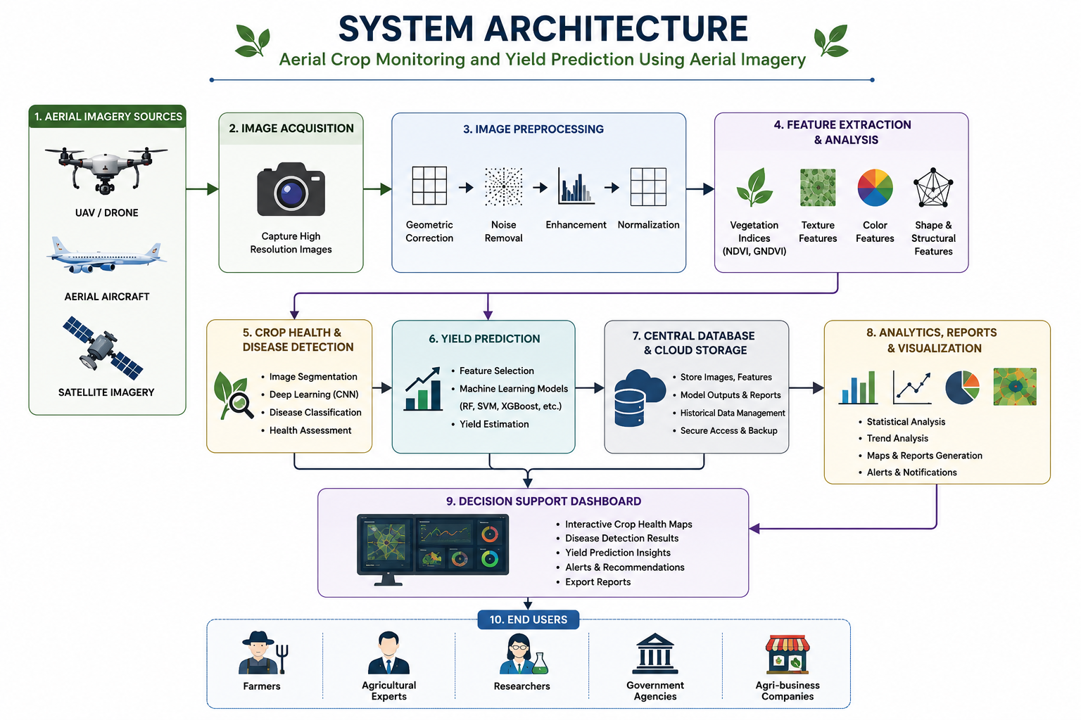

Slide 8
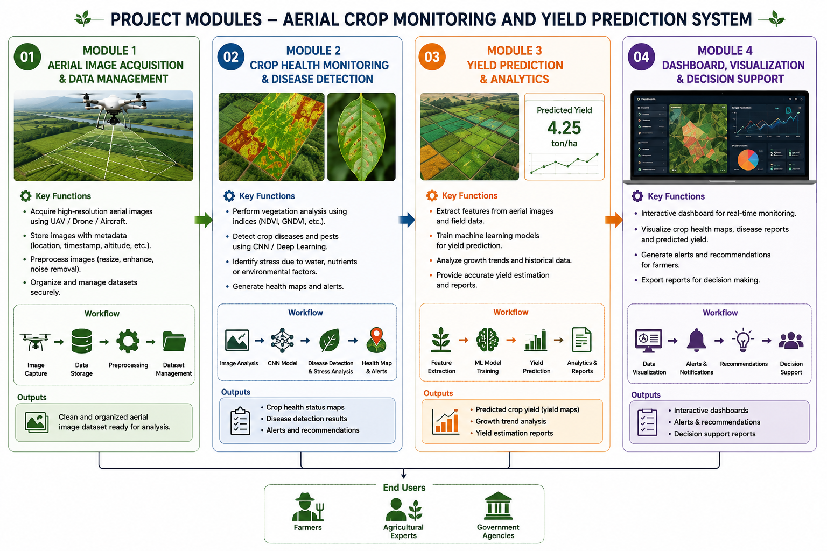
Modules Introduction

Slide 9
Future Enhancements
Integrate multispectral and hyperspectral imagery for improved analysis.
Incorporate real-time IoT sensor data (soil moisture, temperature, humidity).
Develop a mobile application for farmers to access reports and alerts.
Implement real-time monitoring using live aerial image streams.
Expand the system to support multiple crop types and different geographical regions.
Integrate weather forecasting to improve yield prediction accuracy.

Slide 10
Conclusion
The proposed system combines aerial imagery, computer vision, and artificial intelligence to improve precision agriculture.
It enables efficient crop health monitoring, disease detection, and accurate yield prediction.
Interactive visualization and decision-support tools help farmers make informed agricultural decisions.
The system reduces manual effort while increasing productivity and sustainability.
Overall, the project contributes to smarter, technology-driven farming and supports sustainable agricultural development.

